Slide 1
Dsense.AI (Pre-disaster tracking of Human Resource)
IBM Call for Code

Slide 2
Background.
PRESENT SITUATION
Before and during the occurrence of any Mass-scale disaster, there is a huge problem of Management and Estimation for an effective rescue process due to extreme hustle. There is no basis for early preparation as such. This is because there is no real time-detection and tracking of the scale of impact of any calamity.
We aim to predict the Scale of Impact of any calamity affected region by generating a Heat Map of the concerned region. With the availability of the estimated human entrapment density on the heat-map, medical and rescue agencies can prepare accordingly in prior. With the prediction of the regions with maximum impact we can then map them to give rescue agencies a heads up to where to start from with the rescue job or how much resources do we need to commit to any particular place.
Also, with the availability of this dynamically evolving data, one can take better actions for the future disasters with smarter insights.

Slide 3
Dsense.AI
The Idea
Whenever there’s a high probability of an occurrence of any disaster, the cellular/mobile devices in that region, would be triggered to accept the location based tracking. The usage of this location based tracking would be strictly restricted to the duration of disaster. The Cellular towers in the area will start tracking the locations of all the cellular devices in that region. The obtained location data would then be utilized by the application to estimate the density of people trapped in a particular region. Also, the application would suggest the viable rescue plans keeping into record the statistics of that region. These plans would help the concerned rescue and disaster relief agencies to allocate the resources (food, medicines; etc.) accordingly.

Slide 4
Trigger.
Monitor.
Take action.
Accept data from the operators.
View live statistics of the area stuck with calamity.
Allocate resources in a judicial manner.

Slide 5

FLOW
How this will work?

Slide 6
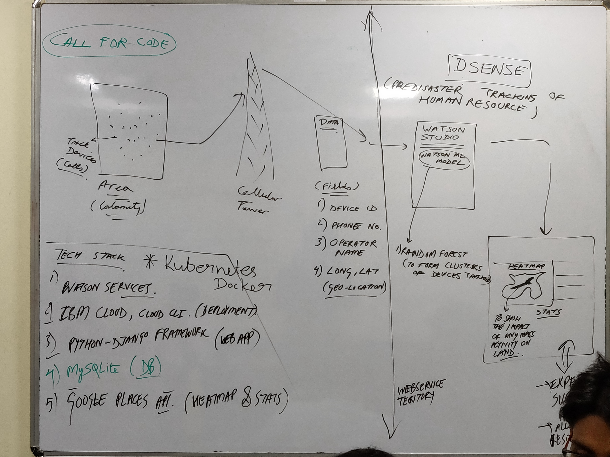

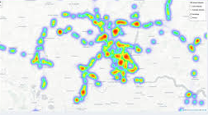
Watson Studio.
Data.
Device ID
Phone Number
Operator Name
Geo-Location
Track Devices
Random Forest Model to form clusters of people.
Cellular Tower
Area of Calamity
Take Action.
Heat
Zones
Predication of major impact zones.
Suggestion of optimum Rescue plans.
Statistics.
DSENSE Boundary

Slide 7
1.
Success Prediction
OBJECTIVES
Our main objective is to make an estimate of number of people trapped in a calamity struck place and give a brief information to agencies in a intuitive way so that the agencies can take actions accordingly.

Slide 8
2.
Demographic study
OBJECTIVES
Our application provides an easy way to get to know about the demographics of any calamity before it actually occurs and that too in real time so that the immediate action is adopted.

Slide 9
3.
HeatMaps for impact study
OBJECTIVES
Heat zones on maps will provide an convenient and more effective way of visualizing the actual condition of the disaster activity.

Slide 10
4.
Resource allocation & Better Preperation
OBJECTIVES
The Location and movement data obtained will be useful in training a predictive model for the better future preparations. Example - Building of Safe zones; etc.

Slide 11
5.
Location preferences
OBJECTIVES
Our model is smart in a way that it also takes into consideration the existence of several locations such as Schools, Markets (High Priority Zones) or Forests (Low Priority Zones) etc.

Slide 12
6.
Post-disaster relocation
OBJECTIVES
With the availability of the last traced location of any victim, it would be easier to find the person post-disaster.

Slide 13

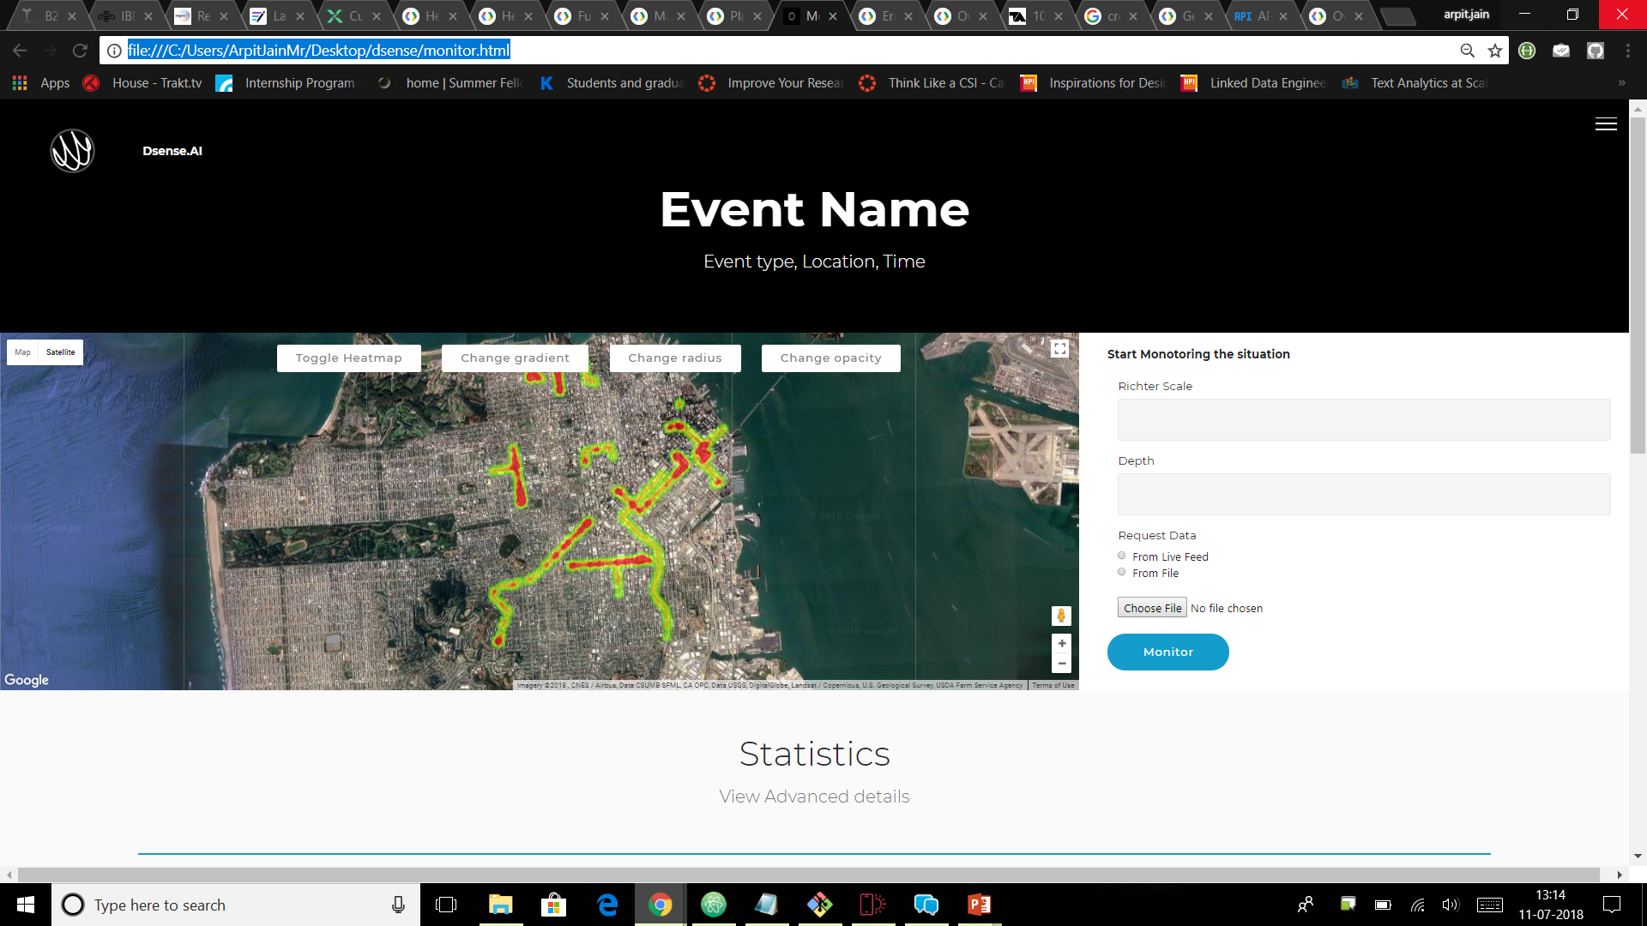
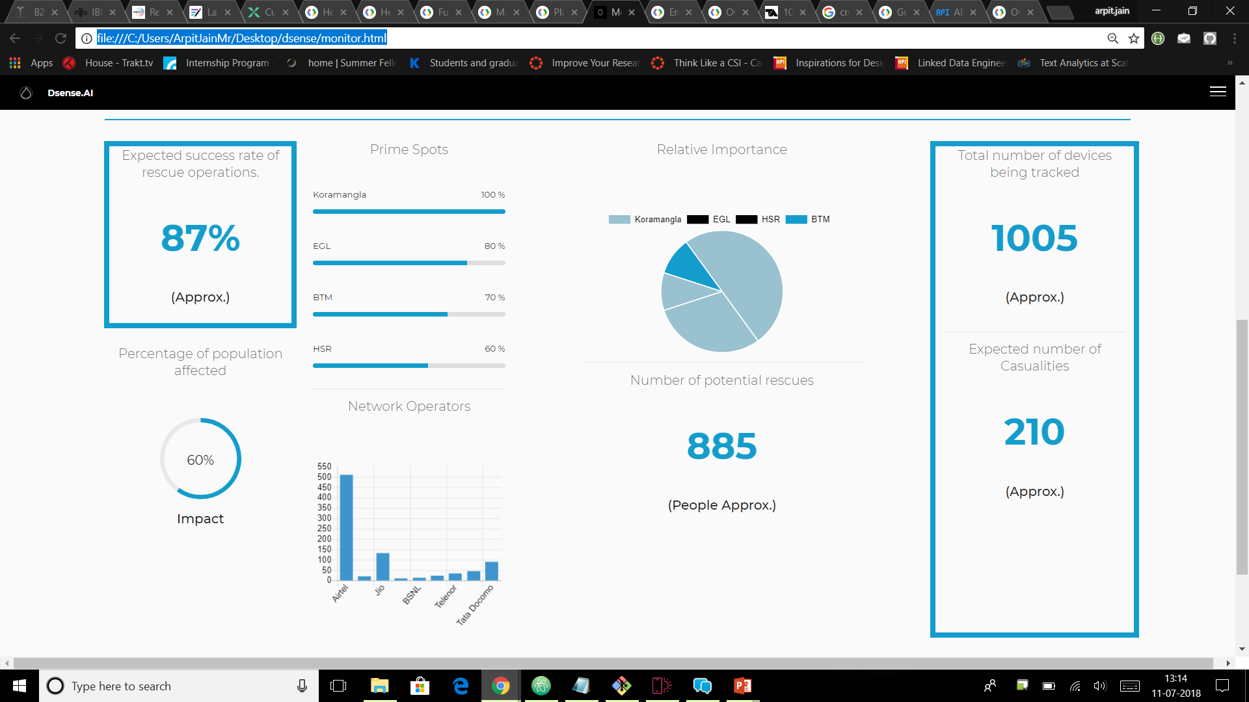
Web App Snapshot
Event Monitoring dashboard

Slide 14
Thanks!
Any questions?

